Slide 1


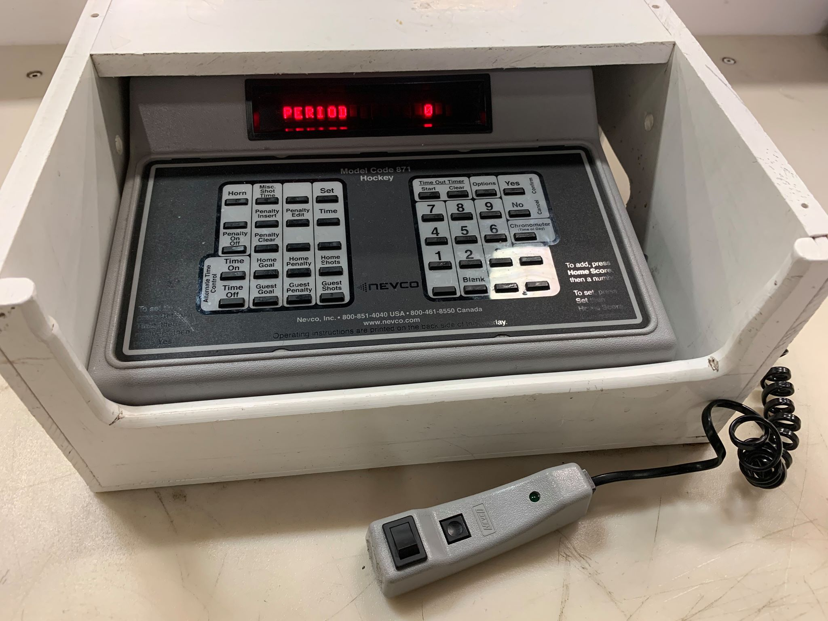
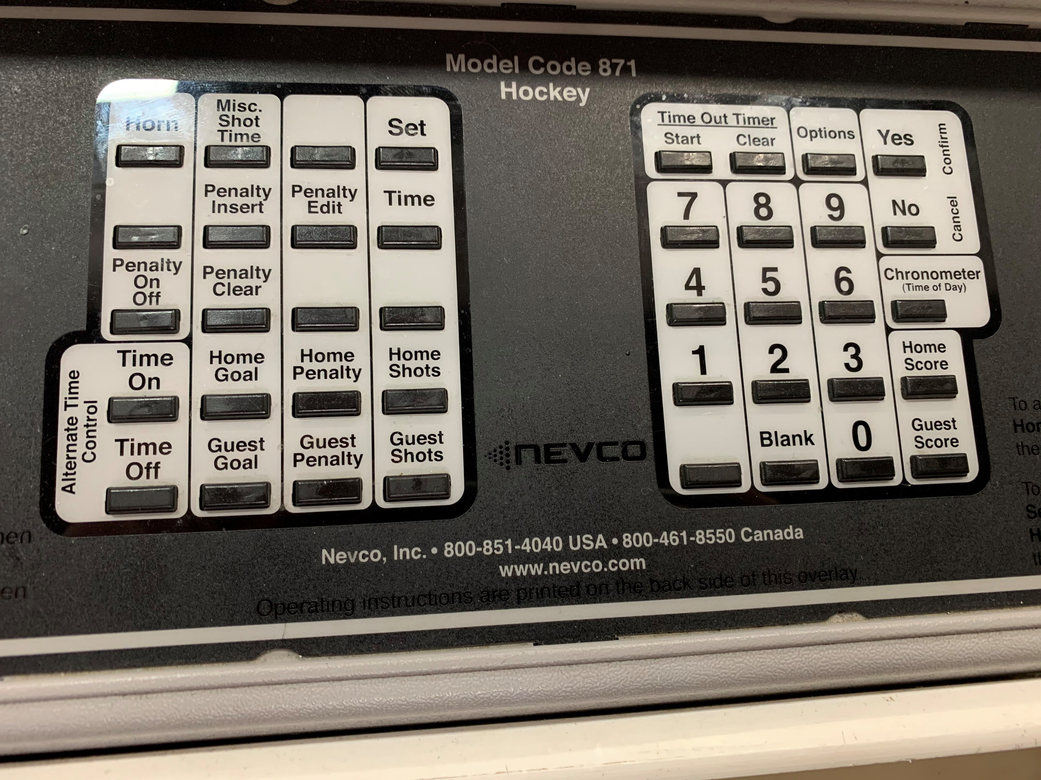
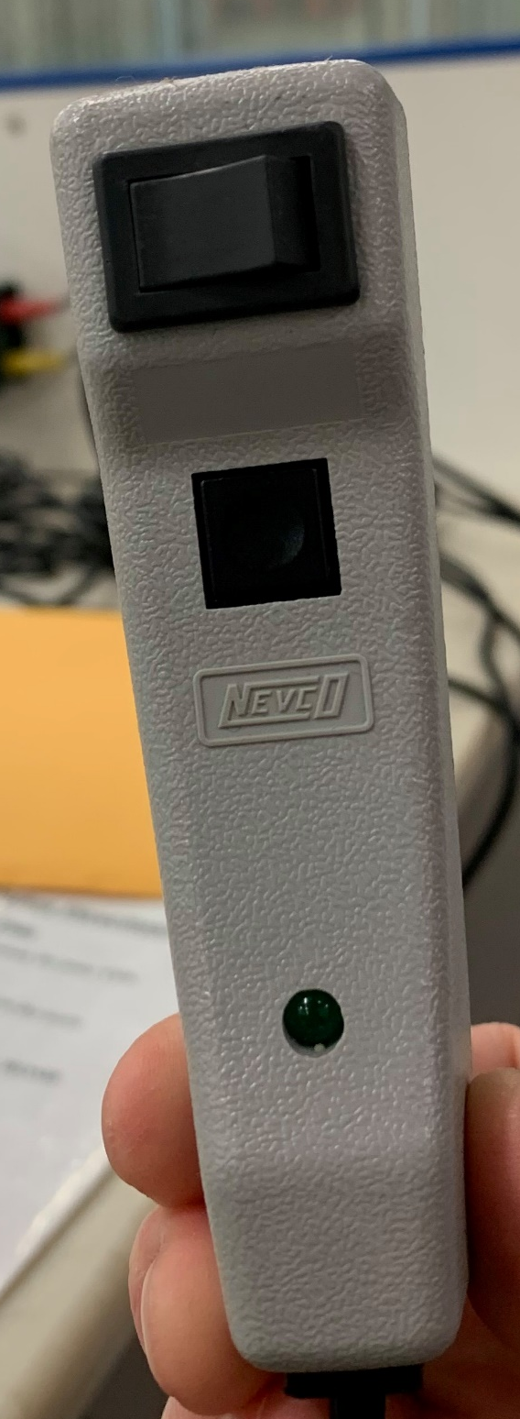
Grande Prairie Minor Hockey
Pomeroy Initiation Mega Tournament
February 11-13, 2022
SCORE CLOCK GUIDELINES & INSTRUCTIONS
Clock OFF
Clock ON
BUZZER
WARM UP (3 MINUTES, begins sharply at GAME TIME to keep schedule on time)
SET the Clock for 3 Minutes
  Press Set
  Press Time
  Enter “0300” on the number pad
  Press Yes
  Display will show Period → Press “0” on the number pad
RUNNING the Clock
  Use the TOP SWITCH on the handheld buzzer switch – Press to the right to start the clock, when time runs out – buzzer will sound automatically, switch clock to left (OFF)
GAME TIME (Each Period is 24 MINUTES)
SET the Clock for 24 Minutes
  Press Set
  Press Time
  Enter “2400” on the number pad
  Press Yes
  Display will show Period → Press 1 on number pad for Period 1 (2 for Period 2)
BEGINNING OF THE PERIOD (REF WHISTLE & PUCK DROP) -- START the CLOCK
  Use the top switch on the handheld buzzer to start the clock
DURING EACH PERIOD -- SHIFT CHANGES every 2 minutes
  SHORT BLAST on the BUZZER, DO NOT STOP THE CLOCK
END OF EACH PERIOD – CLOCK RUNS TO 00:00 -- STOP the CLOCK
  Press switch on the handheld to “OFF”

Slide 2
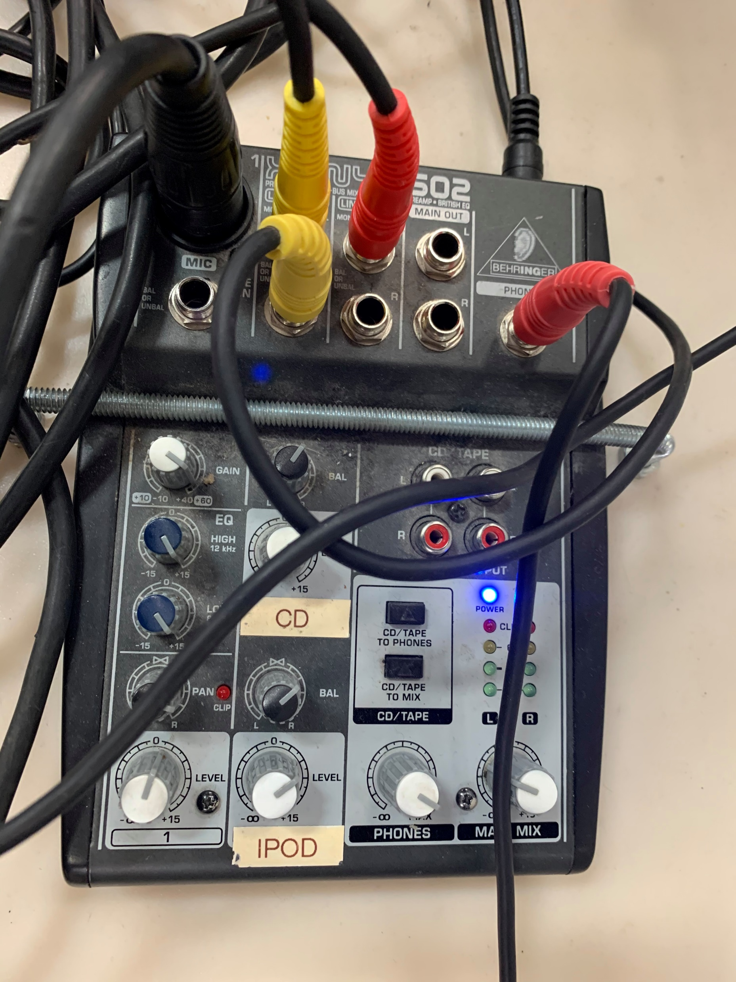

Grande Prairie Minor Hockey
Pomeroy Initiation Mega Tournament
SCORE CLOCK GUIDELINES & INSTRUCTIONS
FIRST GAME for each team: Thank you so much for volunteering!
Play music when the clock starts for the warmup. When the buzzer goes, call both teams and coaches to the blue lilne. We are going to play ‘O Canada’ to begin each game. Please use the microphone to make the following announcement:
“Playing on the East Side of the ice, please welcome Team (away team name & city) & Team (home team name). Playing on the West Side of the ice, please welcome Team (away team name & city) & Team (home team name) to the Pomeroy Initiation Mega Tournament. At this time, I would like to ask the Coaches to have their players line up on the blue line. FANS please stand for the playing of O’Canada”
PLAYING O’CANADA:
Connect iPOD to speakers as shown, select O’Canada and
press Play

Slide 3
Grande Prairie Minor Hockey
Pomeroy Initiation Mega Tournament
February 15-16 2020
SCORE CLOCK GUIDELINES & INSTRUCTIONS
24:00
22:00
20:00
18:00
16:00
14:00
12:00
10:00
8:00
6:00
4:00
2:00
0:00
ALL GAMES
Warm Up = 3 MIN
Period 1 = 24 MIN
Period 2 = 24 MIN
Shift Changes every 2 min
BUZZER
SHIFT CHANGES EVERY 2 minutes
PRESS BUZZER every 2 minutes
1 short blast
DO NOT STOP THE CLOCK

Slide 4
Grande Prairie Minor Hockey
Pomeroy Initiation Mega Tournament
SCORE CLOCK GUIDELINES & INSTRUCTIONS
TO PLAY MUSIC
Plug in and play from playlist. Play during warm up only.

Slide 5
Grande Prairie Minor Hockey
Pomeroy Initiation Mega Tournament
SCORE CLOCK GUIDELINES & INSTRUCTIONS
END OF GAME FOR each team: Thank you so much for volunteering!
Be sure to get the name of the lucky player for each team before the end of the game. Players will line up to shake hands. After players shake hands, please use the microphone to make the following announcement:
“Great game! Please line up on the blue line for our Lucky Player presentation. For (name of home team), the lucky player is (name of player). For (name of away team), the lucky player is ( name of player). Congratulations on a great game!”

